Slide 1
Deno
JUNE 18, 2020
A brand new JavaScript runtime for backend

Slide 2
Section Overview
What is Deno?
Why Deno?
Deno Features
Live examples
WebSockets game

Slide 3
What Is Deno?

Slide 4
What Is Deno?
Deno is a brand new JavaScript/TypeScript runtime for the backend. It was created by the same person, Ryan Dahl, who is also the creator of Node.js.
In 2018 he gave The 10 Things I Regret About Node.js talk at Berlin, where he announced Deno – A new JavaScript & TypeScript runtime.
While both Node and Deno are based on the same V8 Engine, Node was written in C++ and Deno in Rust – a language that offers similar performance as C++ does, but with a special emphasis on security, memory access errors, buffer overflows, etc

Slide 5
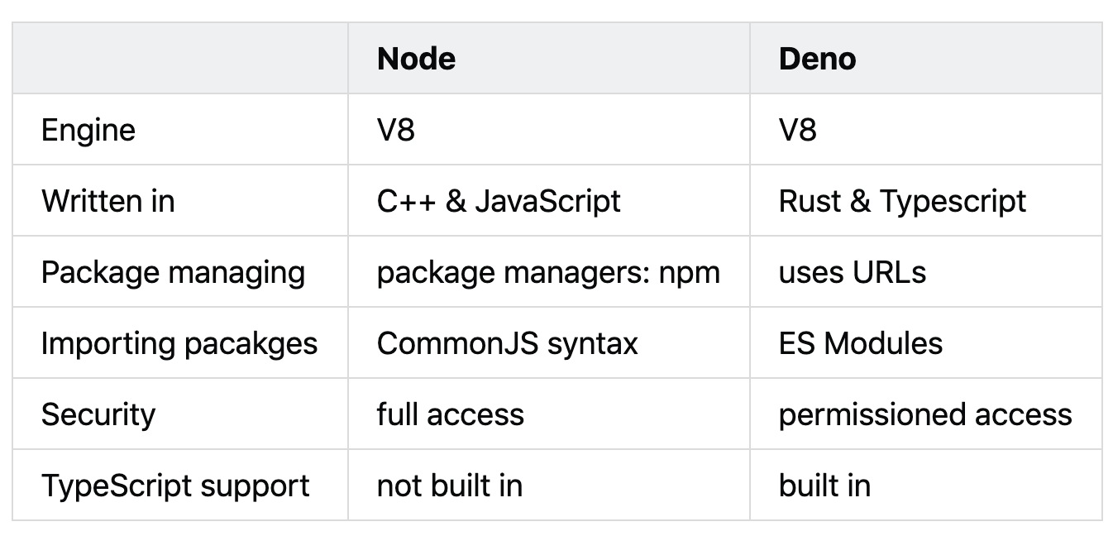
Node vs Deno

Slide 6
Fun fact
”Deno” is actually an anagram of ”Node”
Personal Wild guess
Probably the last JS runtime from Ryan will be called… “Done”?

Slide 7
Why the need of Deno?
Node.js pain points

Slide 8
Why Deno?
According to Dahl, Node.js suffers from three major design issues:
A poorly designed module system, with centralized distribution
Lots of legacy APIs that must be supported
A lack of security

Slide 9
Deno modules
In Node.js you load CommonJS modules, taken from npmjs.com, using the require keyword.
In Deno, you load ES modules using the import keyword by specifying the url: import * as log from “https://deno.land/std/log/mod.ts”
Deno modules can be hosted anywhere. Modules are always cached and compiled locally. Therefore you should be able to run Deno programs that are already on your laptop, as long as all the imports have been resolved once, even if you are offline.
Deno does have a centralized collection of standard modules with no external dependencies. The deno_std is a loose part of Go’s standard library.

Slide 10
Deno secure execution
By default, compared to Node, Deno won’t let a program access disk, network, subprocesses or environmental variables.
To enable such access, for example you can use the following flags for disk access or network:
--allow-read or more specific –allow-read=/tmp
--allow-net=google.com
Another security improvement in Deno is that it always dies on uncaught errors, unlike Node.js

Slide 11
Deno features

Slide 12
Deno Features
Typescript support
Top Level / First Class Await
Secure by default
Built in Testing
De-centralized Packages
Browser Compatible API
Standard Library
Execute Wasm Binaries
ES Modules
Linter, Doc Generator, Dependency Inspector

Slide 13
Deno Features: Security
--allow-all: Allow all permissions
--allow-env: Allow environment access
--allow-hrtime: Allow high resolution time measurement
--allow-net: Allow network access. Optinonal you can specify comma separated list of domains
--allow-read: Allow file system read access. Optional you can specify comma separated list of directories or files
--allow-run: Allow running subprocesses
--allow-write: Allow file system write access. Optional you can specify comma spearated list of directories or files

Slide 14
Deno Features: Decentralized packages…or not!?
No more npm packages / package.json / node_modules
Packages are imported from a URL: https://deno.land/x/<package_name>
Cached to hard drive on load, refresh only if forced to
There is no official governance of 3rd party packages/libraries
There is no version numbering, date released or last update
Nobody is checking libraries for malicious code
There is no registry, no sheriff in Denoland

Slide 15
Deno Features: Standard Library
Extensive standard library of modules audited by the core team and are guaranteed to work with Deno
File system
Datetime
http
Encoding
Async
Websockets
Testing
etc

Slide 16
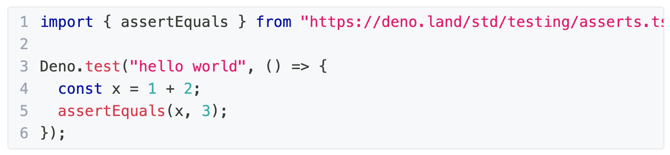
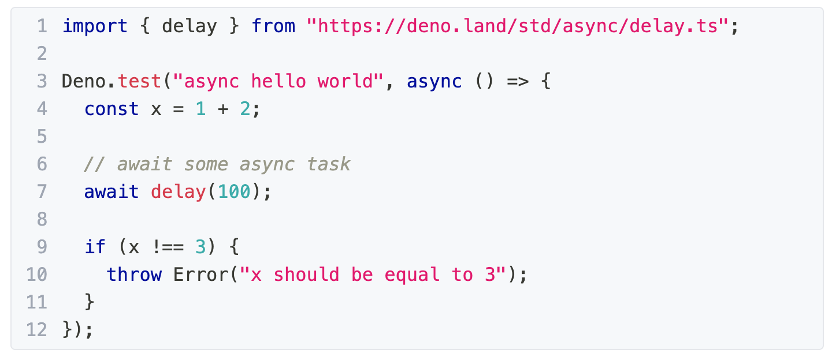
Deno Features: Built In Testing
Deno has a built in test runner that you can use for testing JS/TS code
To run a test use deno test my_Test.ts

Slide 17
Thank you.
Valentin Ovidenie
Consultant
Contact: vovidenie@deloittece.com

